Slide 1
California Wine Production
By Andrew McLaughlin

Slide 2
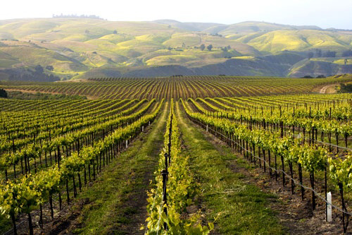
What has happened to California Wine Production since 1980?
How have production levels changed? Are they increasing?
Has wine production moved?

Slide 3
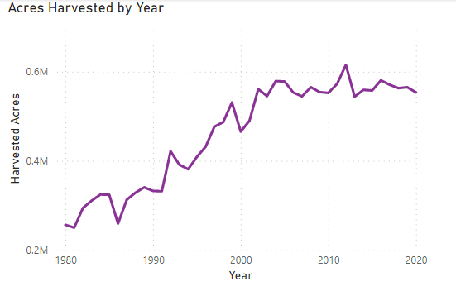
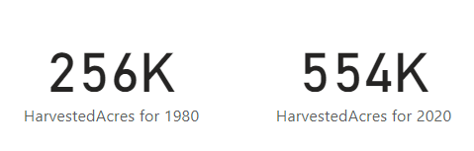
Acres of Wine Harvested has Increased but Stalled
Number of acres of wine harvested has more than doubled since 1980.
Acres harvested has stopped increasing since mid 2000s

Slide 4
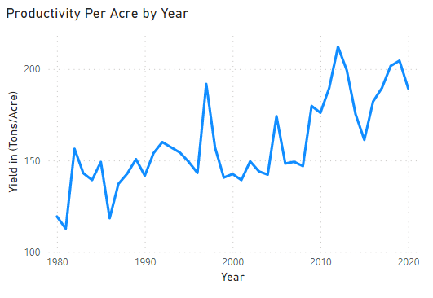
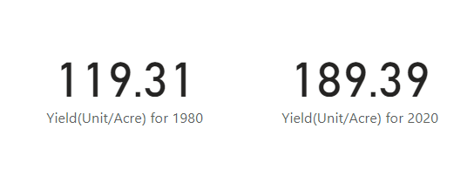
Productivity Per Acre has Increased but Stalled
Each acre produces 58% more wine in 2020 than in 1980.
Gains have diminished in 2010s.

Slide 5
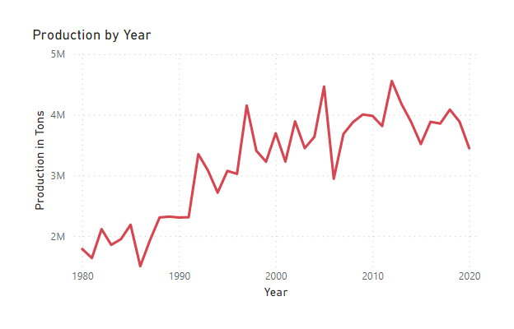
Total Production has Increased since 1980 but Stalled
Gains have diminished in the 21st century.

Slide 6
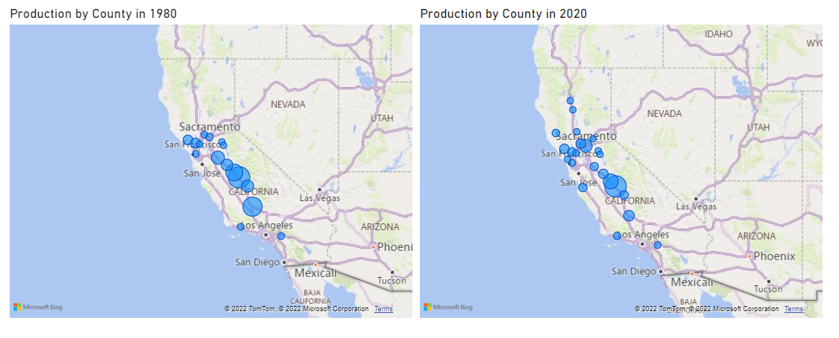
Production has Moved North
From Central Valley in 1980 to Sacramento and north in 2020

Slide 7
Production Has Leveled off and is Moving North
Could global warming be the reason?

